Slide 1
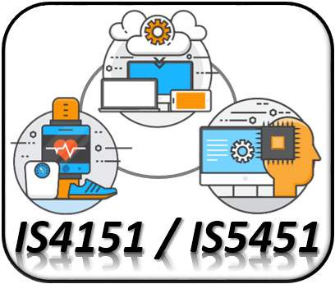
IoT Backend Integration IS4151/IS5451 – AIoT Solutions and Development AY 2024/25 Semester 2
8
Lecture
Lecturer: A/P TAN Wee Kek
Email: tanwk@comp.nus.edu.sg :: Tel: 6516 6731 :: Office: COM3-02-35
Consultation: Tuesday, 2 pm to 4 pm. Additional consultations by appointment are welcome.

Slide 2

Quick Recap…
In the preceding two lectures, we learnt:
The technical characteristics of the Raspberry Pi and appreciate its capability to act as both node device and hub plus edge processing.
How to perform GPIO programming with the Raspberry PI using both digital and analogue signal.
How to control and interact with one or more micro:bit devices via radio and BLE wireless communication.
IoT Development
AI Machine Learning
Single-board Microcontroller
Single-board Computer
IoT Backend Integration
Android Development for IoT
IoT Data Preprocessing
Machine Learning for IoT Data
Computer Vision for IoT
IoT Architecture, Design and Protocols
Pervasive Computing
Technical Concepts
Introduction to Artificial Intelligence of Things

Slide 3
Quick Recap… (cont.)
We now have sufficient knowledge to implement the fog computing and cloud computing architecture.
This lecture continues our learning journey to find out how to:
Connect a node device or hub to a fog processor or cloud server.
Integrate all three architectures of edge, fog and cloud.
IoT Development
AI Machine Learning
Single-board Microcontroller
Single-board Computer
IoT Backend Integration
Android Development for IoT
IoT Data Preprocessing
Machine Learning for IoT Data
Computer Vision for IoT
IoT Architecture, Design and Protocols
Pervasive Computing
Technical Concepts
Introduction to Artificial Intelligence of Things

Slide 4

Learning Objectives
At the end of this lecture, you should understand:
What is Service-Oriented Architecture.
What is RESTful web service.
How to create RESTful web service in Python with Flask and Connexion.
How to test RESTful web service in Postman.
How to consume RESTful web service in Python.
Persisting the data to a relational database.
IoT Development
AI Machine Learning
Single-board Microcontroller
Single-board Computer
IoT Backend Integration
Android Development for IoT
IoT Data Preprocessing
Machine Learning for IoT Data
Computer Vision for IoT
IoT Architecture, Design and Protocols
Pervasive Computing
Technical Concepts
Introduction to Artificial Intelligence of Things

Slide 5

Readings
Required readings:
None.
Suggested readings:
None.

Slide 6

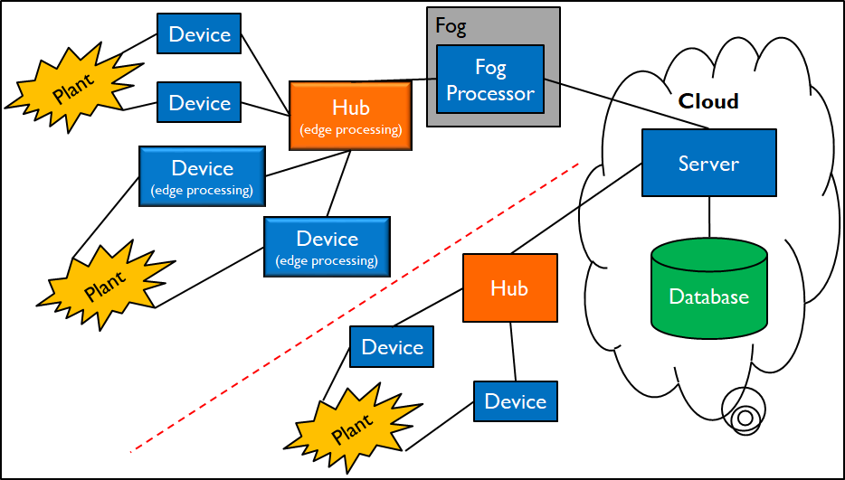
Technical Roadmap for IS4151/IS5451
Single-board Microcontroller
Android Wear
Single-board Computer
Android App
IoT Backend Integration
AI & ML

Slide 7
Quick Recap on IoT System Development…
In a simple IoT system setup, it is not critical to segregate between hub and fog processor.
For simplicity, we use the Raspberry Pi single-board computer in this course as an integrated hub and fog processor:
On the southbound, the Raspberry Pi connects with the micro:bit devices (capable of performing edge processing) to collect sensor values and control their behavior:
This is where we stop last week.
On the northbound, the Raspberry Pi connects with a cloud server to relay data.
At the same time, the Raspberry Pi provides data processing and handles localised information queries.

Slide 8
Quick Recap on IoT System Development…
Raspberry Pi
Southbound
Northbound
AI & ML

Slide 9
In this Lecture…
We continue our journey to learn IoT backend integration using Service-Oriented Architecture SOA.
On the cloud server:
Publishes web services for third parties to consume.
Fog processors or hubs can relay data to the cloud server.
Other third parties can make global information queries.
On the fog processor:
Consumes web services published by the cloud server to relay data.
Also publishes web services for third parties to consume.
Hubs can relay data to the fog processor.
Other third parties can make localised information queries.

Slide 10
In this Lecture… (cont.)
Node (Micro:bit)
Bluetooth Low Energy (BLE)
Hub and Fog Processor
(Raspberry Pi)
RESTful Web Services
Node (Micro:bit)
Relational Database
Node (Micro:bit)
Cloud Server
(Laptop)
Third-Parties
Database Server
(Laptop)
Node (Micro:bit)
Hub and Fog Processor
(Raspberry Pi)
Node (Micro:bit)
The “big picture” and technical roadmap for this lecture
Node (Micro:bit)
Third-Parties
Third-Parties

Slide 11
In this Lecture… (cont.)
Node (Micro:bit)
Radio
Serial USB
Intermediary (Micro:bit)
Hub and Fog Processor
(Raspberry Pi)
RESTful Web Services
Node (Micro:bit)
Relational Database
Node (Micro:bit)
Cloud Server
(Laptop)
Third-Parties
Database Server
(Laptop)
Node (Micro:bit)
Intermediary (Micro:bit)
Hub and Fog Processor
(Raspberry Pi)
Node (Micro:bit)
Node (Micro:bit)
The alternative technical roadmap for this lecture
Third-Parties
Third-Parties

Slide 12
Introduction to Service-Oriented Architecture

Slide 13
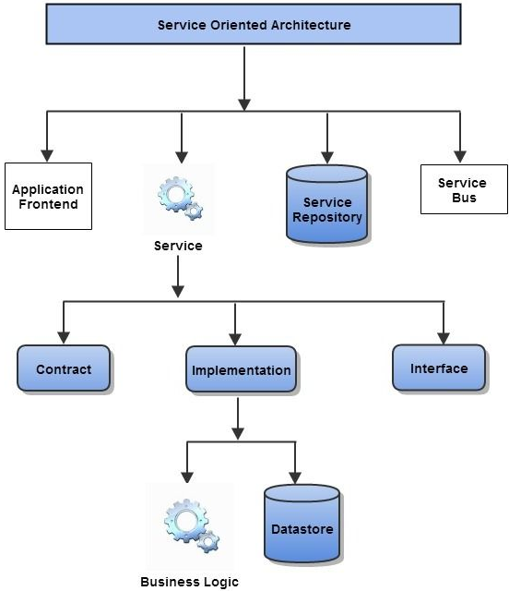
Service-Oriented Architecture
SOA is a software architecture emphasising:
Software components providing services to other components by exchanging messages via a standard network communications protocol (e.g., Simple Object Access Protocol or SOAP).
In theory, a service is a self-contained unit of functionality, such as retrieving the exchange rate for a currency pair.
In practice, a service is an interface definition that may list several discrete services/operations that are semantically related.

Slide 14
Web Services
A service following a standard protocol implemented with any technology can be consumed by another software element implemented with any other technologies.
SOA is typically implemented using the web services approach:
A web service is a service that is offered by one software element to another via communicating over the World Wide Web (WWW).
Machine-to-machine communication is enabled by protocols such as HyperText Transfer Protocol (HTTP).
More specifically, messages (e.g., SOAP) are sent and received over HTTP.

Slide 15
Web Services (cont.)
Web services can be implemented in two ways:
“Big” web services or SOAP web services
RESTful web services.

Slide 16
SOAP Web Services
Use XML messages that follow the Simple Object Access Protocol (SOAP) standard.
SOAP is an XML language defining a message architecture and message formats.
Uses a machine-readable description of the operations offered by the service, written in the Web Services Description Language (WSDL).
WSDL itself is also an XML language but it is used for defining interfaces syntactically.

Slide 17
RESTful Web Services
Representational State Transfer (RESTful) web services is an alternative to SOAP web services:
More suitable for basic, ad hoc integration scenarios.
Better integrated with HTTP than SOAP-based services.
Do not require XML-based SOAP messages or WSDL service-API definitions.
Only requires HTTP.
Desirable characteristics compared to SOAP:
Loose coupling.
Architecturally simplicity.
Ease of consumption on client side.
Use standard HTTP methods to manipulate resources.

Slide 18
RESTful Web Service (cont.)
RESTful principles:
Resource identification through URI.
Uniform interface for manipulating resources using the standard HTTP verbs:
Create – PUT
Read – GET
Update – POST
Delete – DELETE
Self-descriptive messages via decoupled resources that can be represented in any format – XML, JSON, HTML and plain text
RESTful request messages are stateless or self-contained.
Stateful interactions may be achieved by exchanging state – URI rewriting, cookies, hidden form fields.

Slide 19
RESTful Web Service (cont.)
In Python, RESTful web services can be created using:
Flask:
A web application framework for Python.
Connexion:
Connexion is a framework on top of Flask that automagically handles HTTP requests defined using OpenAPI (formerly known as Swagger).
For building open API using RESTful web services.

Slide 20
RESTful Web Services and Relational Databases in Python

Slide 21
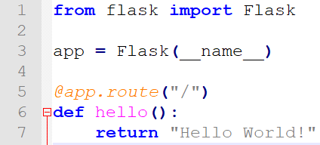

Installing Flask
Flask can be installed with pip using the following command:
python -m pip install flask
To test your Flask installation, create the “Hello World!” Python script below:
To run the script with Flask:
python -m flask --app src01 run
src01.py

Slide 22
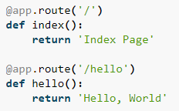
Routing
Modern web applications use meaningful URLs to help users navigate around the websites:
Users are more likely to like a page and come back if the page uses a meaningful URL.
URL helps user to remember a page and use it to visit a page directly.
The route() decorator is used to bind a function to a URL:

Slide 23
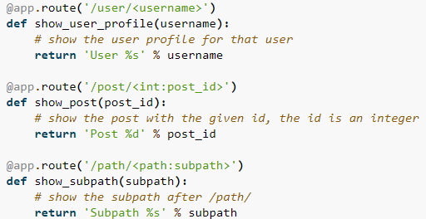
Routing (cont.)
Variables rules:
Add variable sections (a.k.a. path parameters) to a URL by marking sections with the <variable_name> notation.
Python function then receives the <variable_name> as a keyword argument of the same name.
Can use an optional converter to specify the type of the argument like <converter:variable_name>.

Slide 24
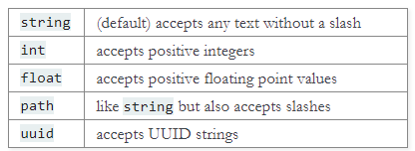
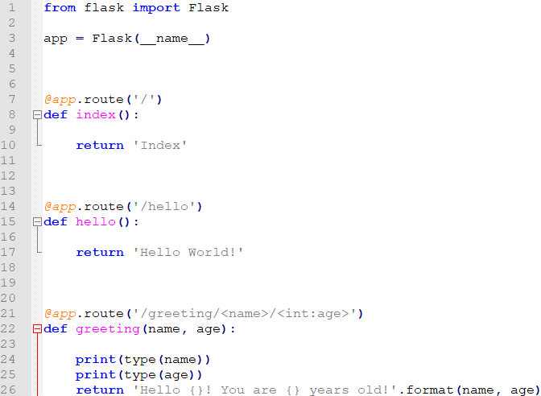
Routing (cont.)
Flask's converters support various primitive types:
src02.py

Slide 25
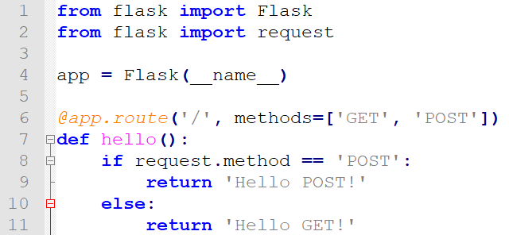
HTTP Methods
Web applications use different HTTP methods when accessing URLs.
By default, a route only responds to GET requests.
You can use the methods argument of the route() decorator to handle different HTTP methods.
src03.py

Slide 26
HTTP Methods (cont.)
What is the advantage of using HTTP POST method?
Data length limit:
GET has a limitation on the length of the values, generally 255 characters.
POST has no limitation on the length of the values.
POST method can be used to send HTML form data to the server:
HTML form data posted to the server are identified by their respective name attribute defined in the corresponding HTML input control.
Data received by POST method is not cached by server and needs to be processed, e.g., saved or persisted into a database.
See sample source file src04.py

Slide 27
Static Files
Most web applications are designed to serve dynamic content.
However, static files such as external JavaScript files and CSS stylesheets are still required.
Flask is configured to serve static files from the static folder in the application folder:
Static files in the static folder will be made available at the URL /static of the web application.
The url_for() method can be used to generate URLs for static files.
E.g., url_for('static', filename='style.css') will reference the file stored at static/style.css.

Slide 28
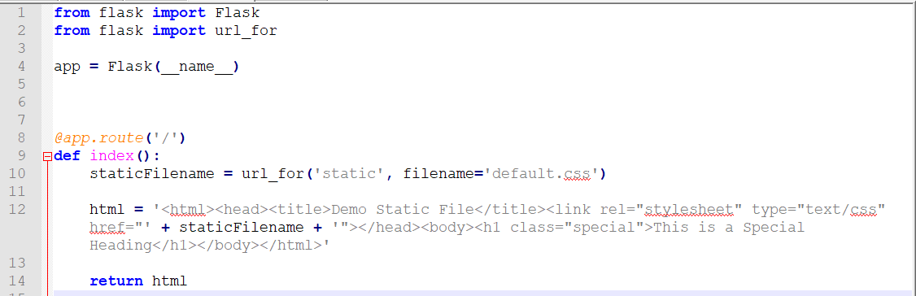
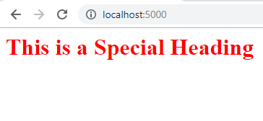
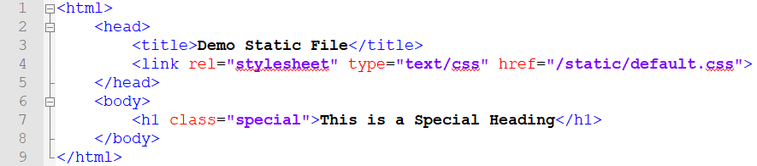
Static Files (cont.)
src05.py

Slide 29
Rendering Templates
Generating HTML from within a Python class is tedious and cumbersome.
Flask is configured with the Jinja2 template engine automatically:
When used for web application, a Jinja template can contain static HTML and dynamic content.
Dynamic content can be rendered using the request, session and g (i.e., application) objects as well as parameters.
The render_template() method is used to render a template:
Provide the name of the template.

Slide 30
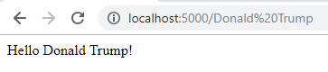
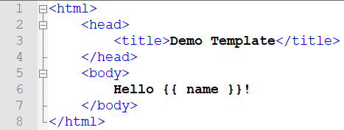
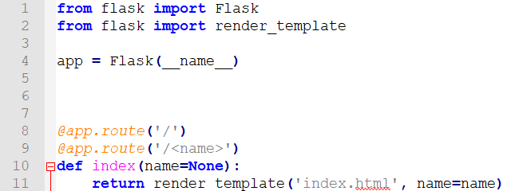
Rendering Templates (cont.)
Provide the variables to be passed to the template engine as keyword arguments.
All template files must be placed in the templates folder.
template/index.html
src06.py

Slide 31
Session State Management in Flask
Session refers to the time interval when a client logs into a server and logs out of it:
The data, which is needed to be held across this session, is stored in a temporary directory on the server.
These are also known as session data or conversational state.
A session with each client is assigned a Session ID.
The Session data is stored on top of cookies and the server signs them cryptographically.
To perform this encryption, a Flask application needs to define a SECRET_KEY, which can be any random string.

Slide 32
Session State Management in Flask (cont.)
In Flask, session data are stored in the session object:
This is a Python dictionary object containing key-value pairs of session variables and associated values.
session['name'] = value is used to set a new session variable.
session.pop('name', None) is used to remove a session variable:
None becomes the default value that is to be returned when the key is not in the dictionary.
See sample source file src07.py for a complete example.

Slide 33
Building RESTful Web Services
Swagger:
An open-source software framework of tools.
Helps developers design, build, document and consume RESTful web services.
Currently known as OpenAPI.
Connexion:
A framework for building and managing RESTful web service in Python on top of Flask using Swagger.
Supports automatic endpoint validation and OAuth2.
Can be installed with pip:
python -m pip install connexion

Slide 34
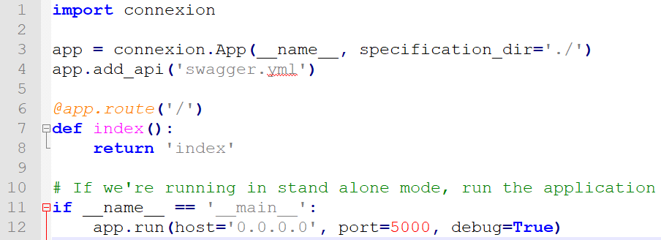
Building RESTful Web Services (cont.)
To add a RESTful web service endpoint to a Flask application:
Need to import the connexion module.
Then create a Swagger configuration file.
src08.py

Slide 35
Building RESTful Web Services (cont.)
Let's examine the details in src08.py:
import statement adds the connexion module to the program.
Create the application instance using Connexion rather than Flask:
Internally, the Flask app is still created but it now has additional functionality added to it.
A Connexion app can still serve HTML content.
The app instance creation command includes the parameter specification_dir.
This parameter tells Connexion which directory to look in for its configuration file.
In this case, the configuration file is placed in the current directory.

Slide 36
Building RESTful Web Services (cont.)
Configure the app instance to:
Read the file swagger.yml from the specification directory.
Provide the corresponding Connexion functionalities.

Slide 37
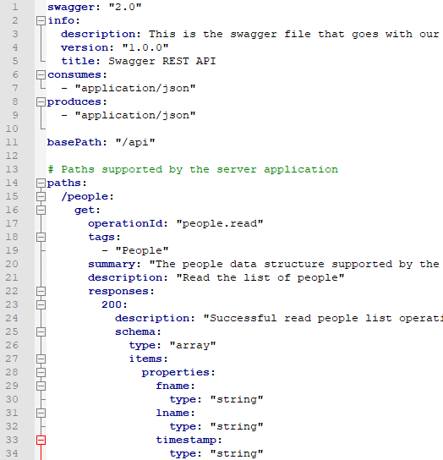

Swagger Configuration File
Configuration file:
YAML or JSON file containing information to configure the server to provide:
URL endpoint definition.
Input parameter validation.
Output response data validation.
Swagger UI.
YAML is a human-readable data serialization format – YAML Ain’t Markup Language
swagger.yml

Slide 38
Swagger Configuration File (cont.)
swagger.yml file defines the GET /api/people endpoint that our RESTful web service will provide.
The file is organized in a hierarchical manner:
The indentation levels represent a level of ownership, or scope.
paths section defines the prefix string of the URLs for the API endpoints:
The /people value indented under paths defines the prefix string for all the /api/people URL endpoints.
The get: indented under /people defines the section of definitions associated with an HTTP GET request to the /api/people URL endpoint.
The same format is used to organize the remainder of the configuration for other API endpoints.

Slide 39
Swagger Configuration File (cont.)
Global configuration information:
swagger – Specify version of the Swagger API being used.
info:
Begins a new “scope”' of information about the API being built.
description:
A user defined description of what the API provides.
This will be used in the Connexion generated UI system.
version – A user defined version value for the API.
title – A user defined title included in the Connexion generated UI system.
consumes – Tells Connexion what MIME type is expected by the input of the API.

Slide 40
Swagger Configuration File (cont.)
produces – Tells Connexion what MIME type is expected by the caller of the API’s output.
basePath – "/api"
Defines the root of the API.
Path without basePath as the prefix will be served by Flask.
paths section begins the configuration of the actual API REST endpoints:
/people – Defines the path for the URL endpoint.
get (can include other HTTP methods):
Defines the HTTP method this URL endpoint will respond to.
Together with the previous definitions, this creates the GET /api/people URL endpoint.

Slide 41
Swagger Configuration File (cont.)
The next section defines the configuration of the single GET /api/people URL endpoint:
operationId:
“people.read” defines the Python import path/function that will respond to a HTTP GET /api/people request.
operationId can go as deep as required to connect a Python function to the HTTP request.
E.g., <package_name>.<package_name>.<package_name>. <function_name> would work too.
tags:
Defines a grouping for the UI interface.
All HTTP methods that are defined for the people endpoint will share this tag definition.

Slide 42
Swagger Configuration File (cont.)
summary – Defines the UI interface display text for this endpoint.
description – Defines what the UI interface will display for implementation notes.
The last section defines the configuration of responses from the URL endpoint:
responses – Defines the beginning of the expected response section.
200:
Defines the section for a successful response, i.e., HTTP status code 200.
Responses for other HTTP status codes can also be configured.

Slide 43
Swagger Configuration File (cont.)
description – Defines the UI interface display text for a response of 200.
schema – Defines the response as a schema, or structure.
type – Defines the structure of the schema as an array.
items – Define the items in the array.
properties – defines the items in the array as objects having key/value pairs:
fname – Defines the first key of the object.
type – Defines the value associated with fname as a string.
lname – Defines the second key of the object.
type – Defines the value associated with lname as a string.
timestamp – Defines the third key of the object.
type – defines the value associated with timestamp as a string.

Slide 44
Handler for RESTful Web Service Endpoint
Recall that in swagger.yml, we have configured Connexion with:
The operationId value to call the people module.
The read function within the module is invoked when the API receives an HTTP request for GET /api/people.
This means a people.py module must exist and contain a read() function.
Important notes about the sample code:
PEOPLE is a dictionary data structure:
This is a simple names database, keyed on the last name.
This is a module variable, so its state persists between method calls:
Can modify the data structure.

Slide 45
Handler for RESTful Web Service Endpoint (cont.)
In a real application, the PEOPLE data will exist in a database, i.e., persists the data beyond the web application instance.
read() function:
Invoked when an HTTP request to GET /api/people is received by the server.
Return value of this function is converted to a JSON string (recall the produces definition in the swagger.yml file).
Builds and returns a list of people sorted by last name.
Use the following command to run the Connexion app:
python src08.py

Slide 46
The Swagger UI
What have been demonstrated thus far:
A simple RESTful web service running with a single URL endpoint.
swagger.yml provided a definition for the code path connected to the web service endpoint.
In addition, Swagger UI is automatically created for our web service:
Requires installation of the connexion module with an additional swagger-ui option:
python -m pip install connexion[swagger-ui]

Slide 47
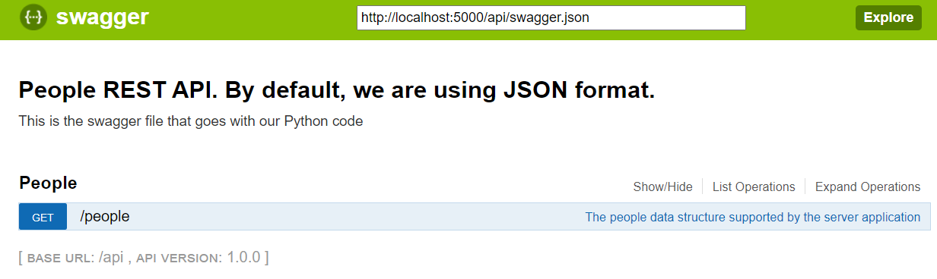
The Swagger UI (cont.)
Navigating to http://localhost:5000/api/ui/ will launch a web page that resembles the screenshot on the next slide.
Note the trailing slash in the URL.
The above screenshot shows the initial Swagger interface with the list of URL endpoints supported.

Slide 48
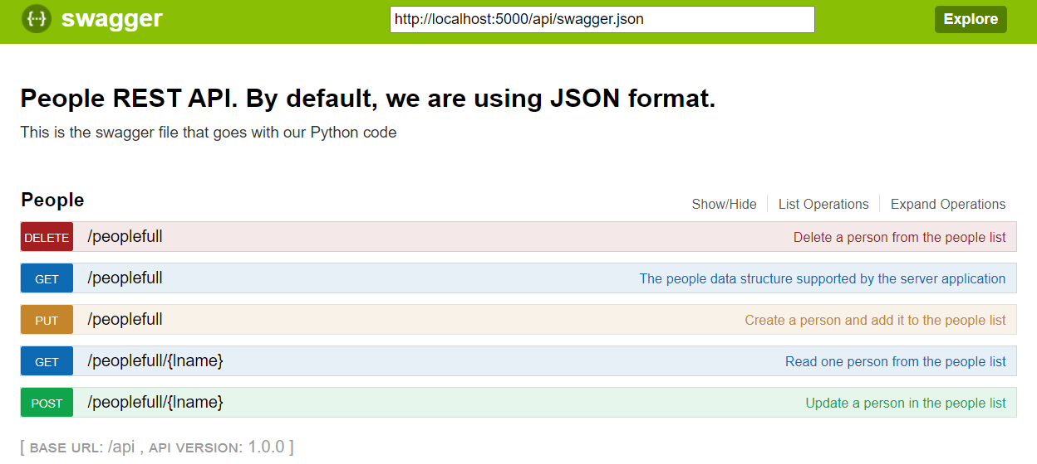
Building the Complete RESTful Web Service
The ultimate goal is to build a RESTful web service that provides full CRUD access to our PEOPLE data structure.
Refer to swaggerfull.yml and peoplefull.py for the complete implementation of the remaining use cases.

Slide 49
Building the Complete RESTful Web Service (cont.)
It is relatively easy to create a comprehensive RESTful web service with Python:
Use the connexion module and some additional configuration.
A useful documentation and interactive system can also be put in place.

Slide 50
Testing RESTful Web Service with Postman
Postman (https://www.postman.com/) can be used to test RESTful web service methods:
Indicate the required URI of the resource.
Select the required HTTP verb corresponding to the web service method.
Based on the HTTP verb of the resource being called, the following parameters would need to be provided:
Header field(s).
Query string parameter(s).
Path parameter(s).
Body of the HTTP PUT and POST request:
Mainly for JSON formatted requests.

Slide 51
Consuming RESTful Web Service in Python
Python requests library:
requests is a Python library that enables the sending of HTTP requests.
requests library supports the four main HTTP request methods of get(), put(), post() and delete().
Use the following command to install the library:
python -m pip install requests
The put() and post() methods allow data to be sent to the server as a JSON object:
In Python, a dict data structure can be converted into a JSON object using the Python json library.

Slide 52
Consuming RESTful Web Service in Python (cont.)
Configure the headers:
Set “content-type” value to “application/json”:
Matches the consumes configuration of the web service.
The get() and delete() methods allow params representing the path or query string parameters to be passed in as a dict object.
Sample source file src09.py demonstrates how to call the people web services using the requests library.

Slide 53
Persisting Data to a Relational Database
Python provides an elaborate set of libraries for working with relational database management systems (RDBMS):
Most major RDBMSs such as SQLite, MySQL and PostgreSQL are supported.
MySQL Connector for Python – Driver and API for MySQL.
SQLAlchemy – An open-source SQL toolkit and object-relational mapper (ORM) for Python.
On the Raspberry Pi, due to the lower computational capability, SQLite is preferable to MySQL:
SQLite is serverless whereas MySQL is server-based.
Bear in mind that we are also running other IoT control applications, connexion, etc.

Slide 54
Persisting Data to a Relational Database (cont.)
Sample source code src10.py demonstrates how to work with MySQL Connector for Python:
Need to install the driver with pip:
python -m pip install mysql
python -m pip install mysql-connector-python
Use basic SQL DML (data manipulation language) statements to complement the CRUD use cases for the people structure.
We will not be using ORM.

Slide 55
Case Study Walk-through

Slide 56
Ambient Temperature Case Study
Suppose we want to track the ambient temperature across a large geographical region:
The region is broken down into several areas.
Each area is further broken down into several districts.
Sensor nodes are deployed across the entire region with multiple nodes monitoring the ambient temperature of each district.
Sensor nodes in each district reports their sensor data to a hub and fog processor at the area-level.
The fog processor in term relays the sensor data at periodic interval to a cloud server at the region-level.

Slide 57
Ambient Temperature Case Study (cont.)
Hub:
Provides Internet connectivity to the node devices.
Fog processor:
Provides temperature information services to local municipal authority for monitoring temperature changes within its area.
Fast response time to dispatch resources.
Cloud server:
Provides temperature information services to central government authority for monitoring temperature changes at the region-level.
Sufficient response time to escalate central resources to assist local resources.

Slide 58
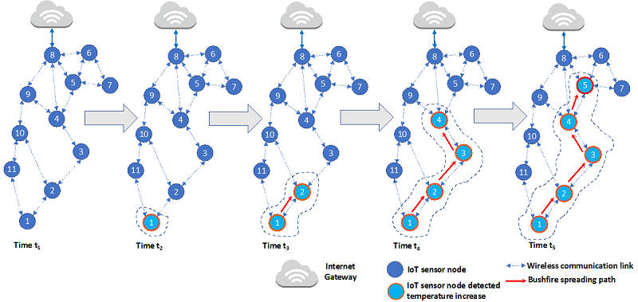

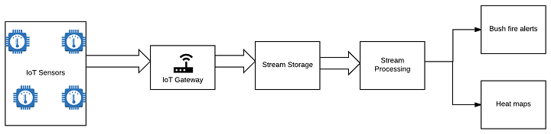
Ambient Temperature Case Study (cont.)
A plausible scenario in the real-world:
Real-time bushfire alerting with complex event processing.

Slide 59
Demonstration Setup
Node (Micro:bit)
Bluetooth Low Energy (BLE)
Hub and Fog Processor
(Raspberry Pi)
RESTful Web Services
Node (Micro:bit)
Relational Database
Node (Micro:bit)
Cloud Server
(Laptop)
Third-Parties
Database Server
(Laptop)
Third-Parties

Slide 60
Demonstration Setup (cont.)
Bluetooth Low Energy (BLE)
node.js
hub.py
fog.py
cloudrelay.py
RESTful Web Services
Relational Database
node.js
cloud.py
temperature.db
node.js
temperature (MySQL)
Third-Parties
Third-Parties

Slide 61
Demonstration Setup (cont.)
Node (Micro:bit)
Radio
USB
Intermediary (Micro:bit)
Hub and Fog Processor
(Raspberry Pi)
RESTful Web Services
Node (Micro:bit)
Relational Database
Node (Micro:bit)
Cloud Server
(Laptop)
Third-Parties
Database Server
(Laptop)
Third-Parties

Slide 62
Demonstration Setup (cont.)
Radio
USB
rnode.js
rhub.py
fog.py
cloudrelay.py
RESTful Web Services
Relational Database
rnode.js
rcontroller.js
cloud.py
temperature.db
rnode.js
temperature (MySQL)
Third-Parties
Third-Parties

Slide 63

Summary
RESTful web services provide a lightweight and flexible approach for software elements in an IoT system to interact with each other.
Single-board computer such as the Raspberry Pi can act as an integrated hub and fog processor by running RESTful web services and relational databases on it.

Slide 64

Q&A

Slide 65

Next Lecture…
Learn about:
More about machine learning.
How to perform data preparation with Pandas.
How to perform data visualisation with Matplotlib.
IoT Development
AI Machine Learning
Single-board Microcontroller
Single-board Computer
IoT Backend Integration
Android Development for IoT
IoT Data Preprocessing
Machine Learning for IoT Data
Computer Vision for IoT
IoT Architecture, Design and Protocols
Pervasive Computing
Technical Concepts
Introduction to Artificial Intelligence of Things

